Slide 1

Automated MIMO Selection Model
Department of Electronics and Communication Engineering
Acharya Institute of Technology
Soladevanahalli, Bengaluru 560 107
Project Presentation on :
Presented by :
Name | USN
Vikshith H G | 1AY15EC108
Meghana P | 1AY15EC059
Under the guidance of :
SIDDESH M B
Asst. Prof. Grade I
Department of ECE,
Acharya Institute of Technology

Slide 2
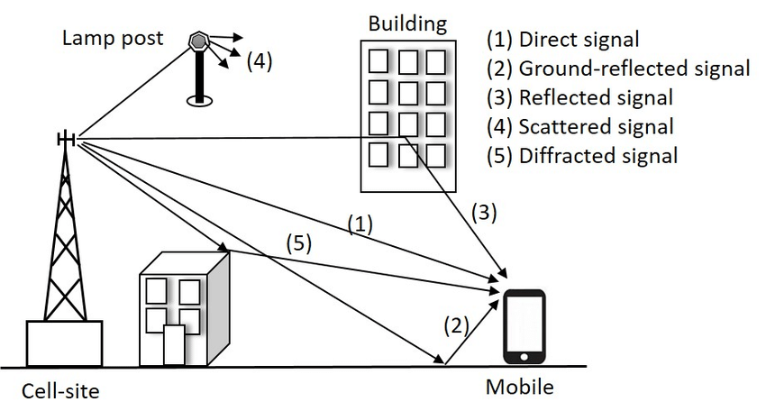
Introduction
MIMO wireless communication has different factors like fading, power consumption which affects the efficient communication.
The Automated MIMO routing model helps in changing the path of the communication to efficient path by reducing the power consumption and also helps in getting link reliability with improved throughput.

Slide 3
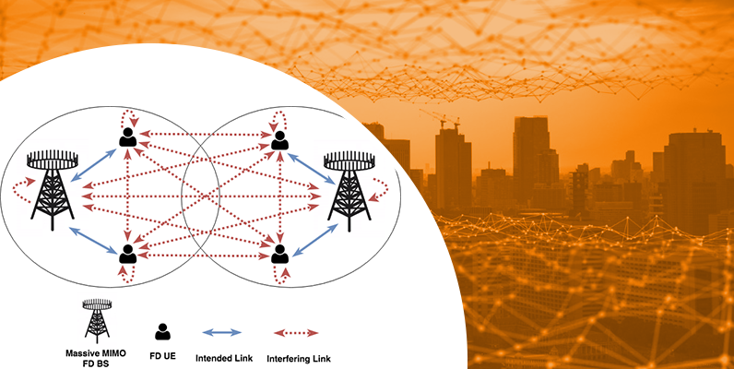
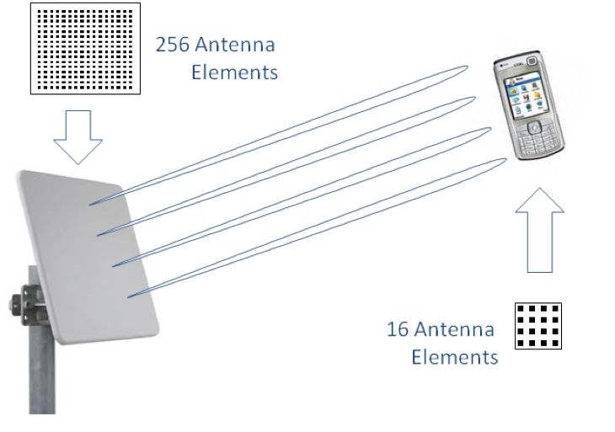
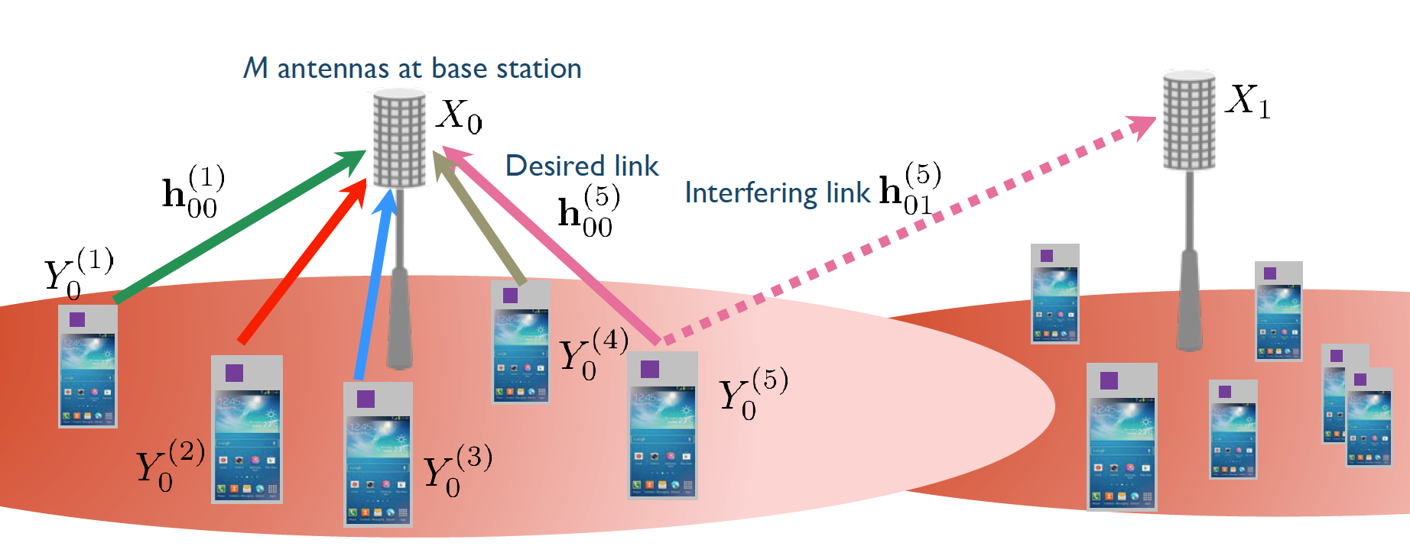
Motivation :

Slide 4
Objective:
The main objective of this project is to develop an algorithm for efficient selection of transmitting and receiving antennas in Multiple-input Multiple-output propagation system
It includes design of simulated signal scatterers, array of antennas
It also includes design of feedback system to MIMO propagation system

Slide 5
Literature Survey
Title of Paper | Journal Published | Authors | Content Referred
Design and performance analysis of MIMO-OFDM system using different antenna configurations | International conference on electrical, electronics and optimization techniques (ICEEOT) -2016 | Arun Agarwal Dept of ECE ITER Saurabh N Mehta Dept ECE Vidyalankar I T Mumbai | MIMO and OFDM concepts and future works
Review on MIMO antenna system design | International Conference on microwave and optical Communication Engineering, December 18-20, 2015, IIT Bhubaneswar, India | D.P.Kshirsagar, S.K.Jain, S.Sharma Department of electronics and telecommunication S.G.S.I.T.S Indore, India | REVIEW ON MIMO & FUTURE SCOPE AND DISSCUSSION
14-06-2019
Dept Of ECE
5

Slide 6
Block Diagram
Signal scatterers
Transmitters
Receivers
Wireless MIMO antenna system
Transmitter Antenna Selector
Parameter recorder
ALU
Receiver Antenna Selector
Analyser and Feedback System
MAXIMUM GAIN OUTPUT

Slide 7
Work Done:
Design and calculations related to antenna node placement in simulation resembling real world scenario
Design related to mobility of movable antenna elements
Design of simulation environment in NS2 using tcl script

Slide 8
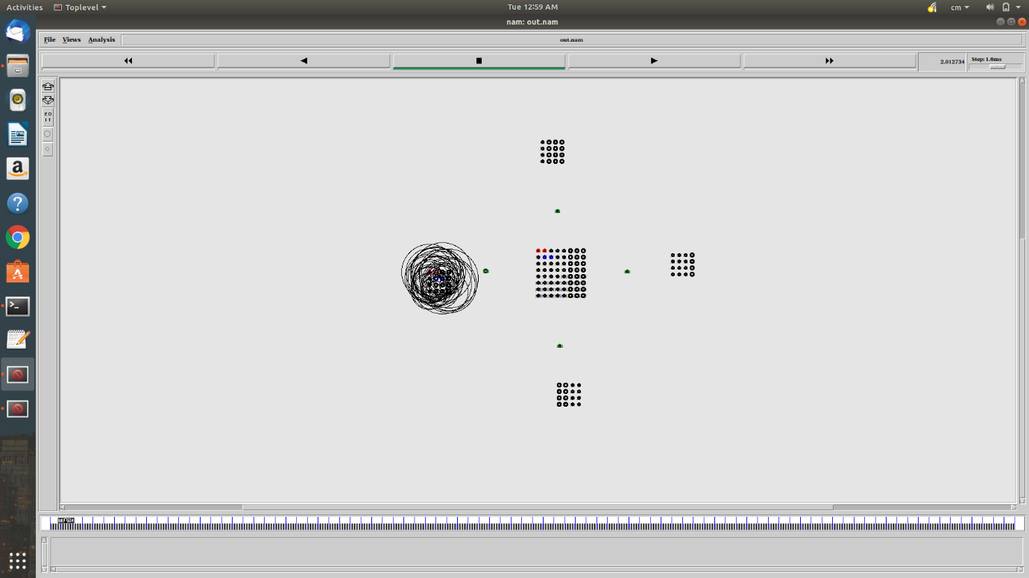
Simulation Result
Simulation of MIMO system is done and the results obtained consist of trace file of MIMO antenna system

Slide 9
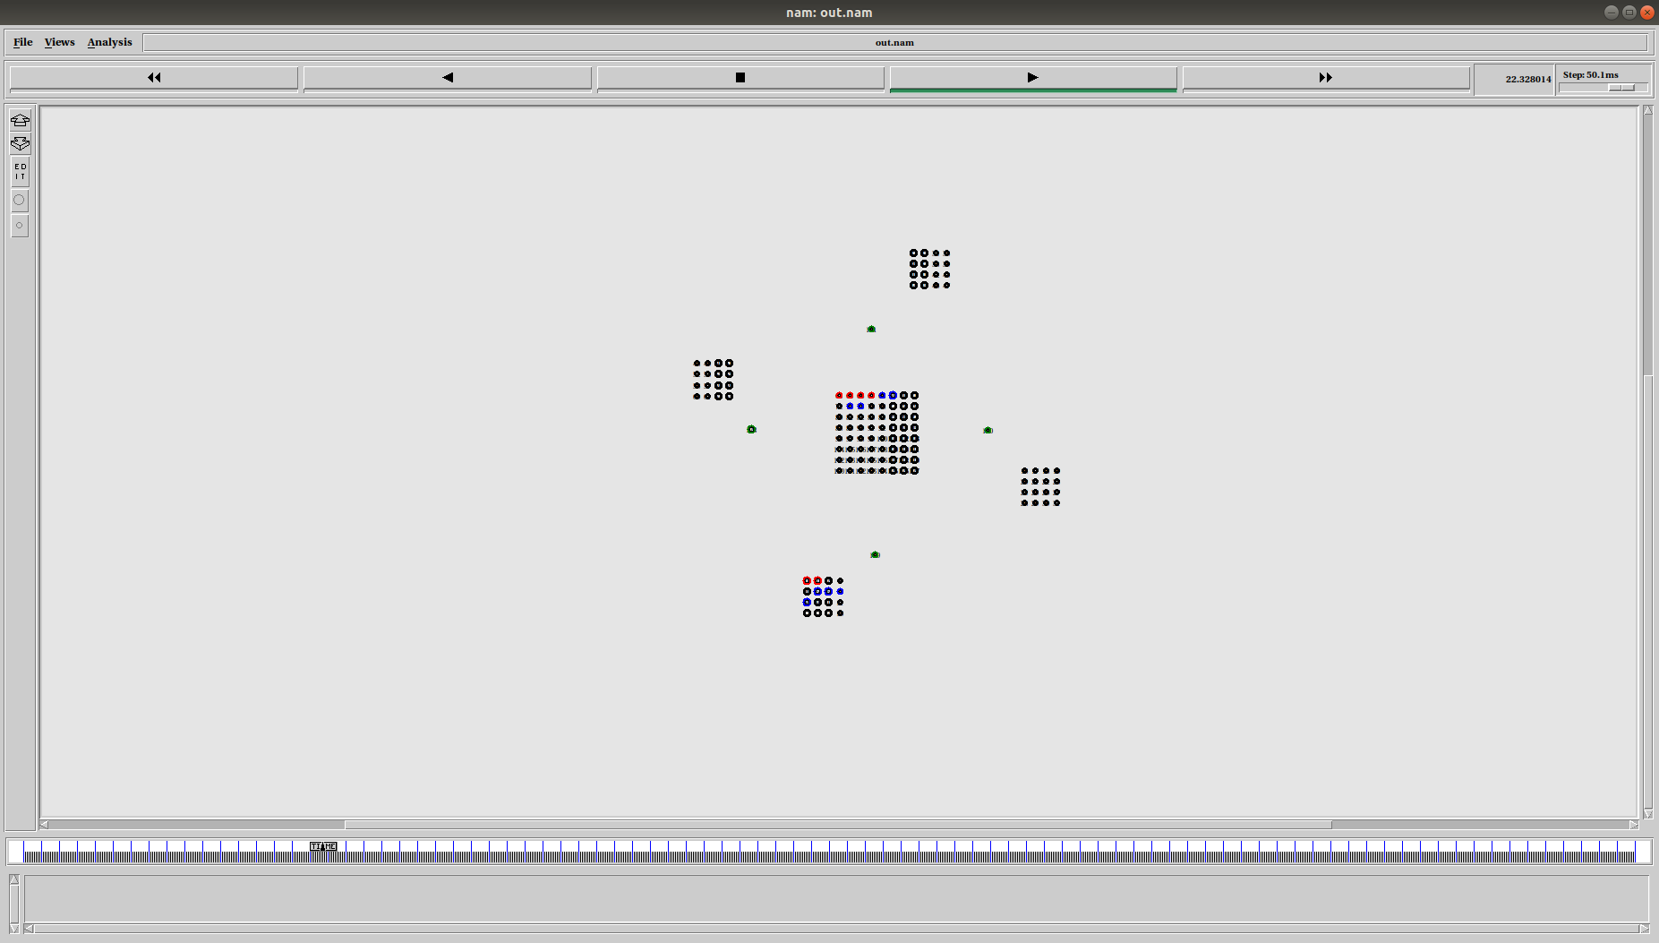

Slide 10
Future scope
An efficient algorithm can be designed for antenna selection
Addition of AI or machine learning for design of algorithms can make MIMO system much more efficient in power consumption

Slide 11
THANK YOU

